Slide 1

Welcome to our Presentation

Slide 2
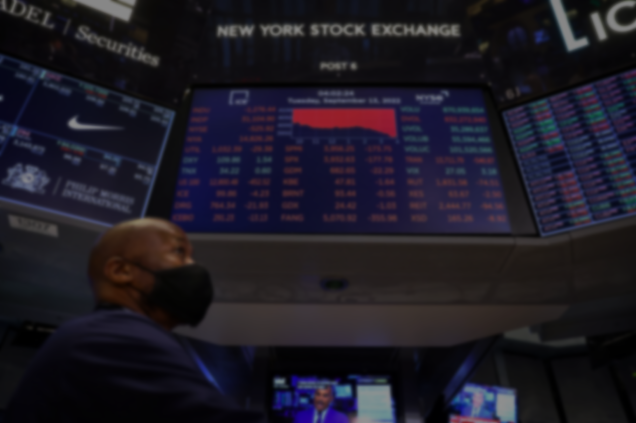
US share market’ company
The United States has two major stock exchanges: the New York Stock Exchange (NYSE) and the Nasdaq. These exchanges are home to thousands of publicly traded companies, representing a wide range of industries and sectors.

Slide 3
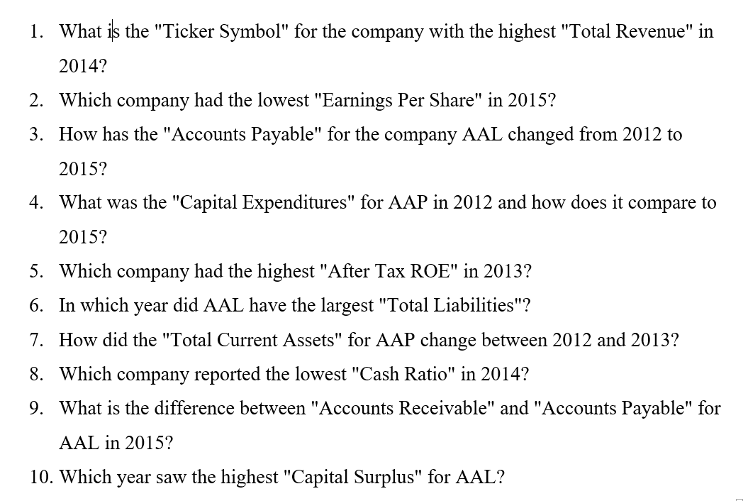
Questions for Analysis

Slide 4
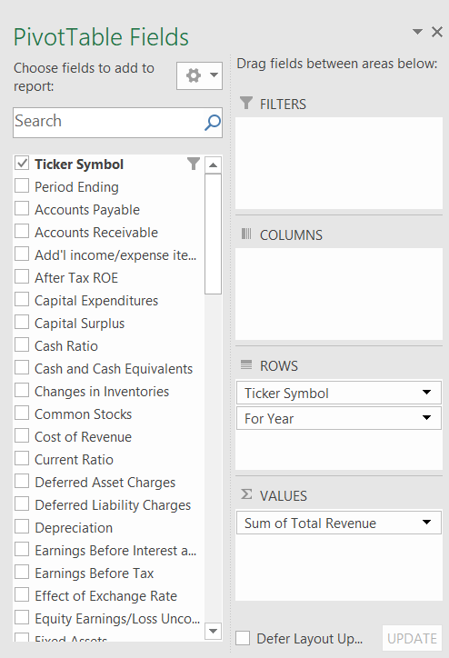
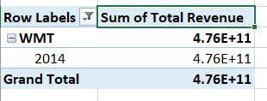
What is the "Ticker Symbol" for the company with the highest "Total Revenue" in 2014?

Slide 5
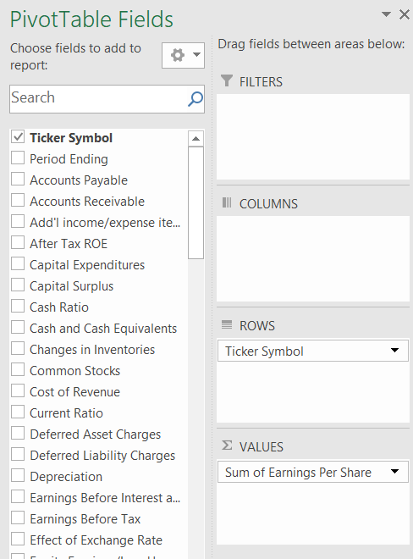
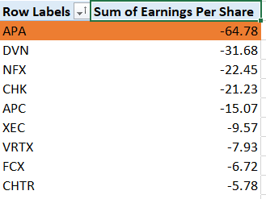
Which company had the lowest "Earnings Per Share" in 2015?

Slide 6
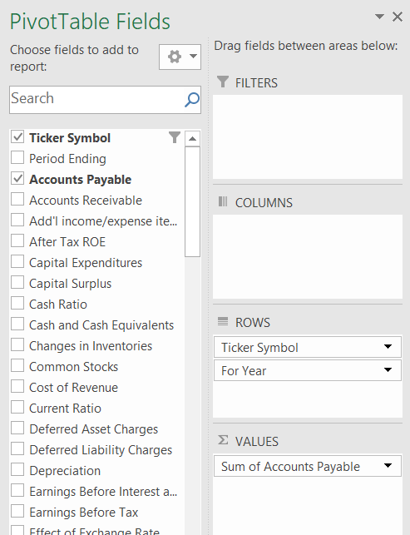
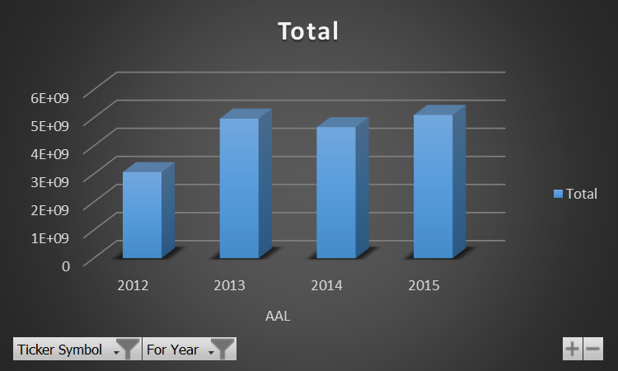
How has the "Accounts Payable" for the company AAL changed from 2012 to 2015?
Row Labels | Sum of Accounts Payable
AAL | 17813000000
2012 | 3068000000
2013 | 4975000000
2014 | 4668000000
2015 | 5102000000
Grand Total | 17813000000

Slide 7
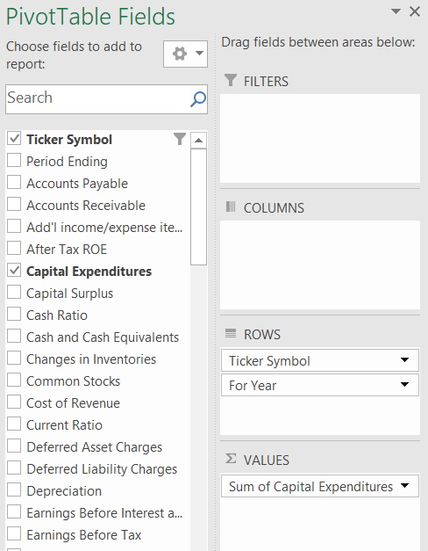
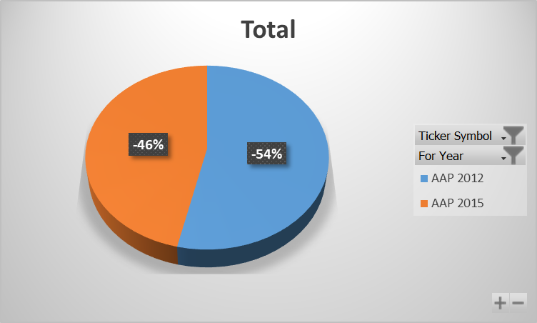
What was the "Capital Expenditures" for AAP in 2012 and how does it compare to 2015?
Row Labels | Sum of Capital Expenditures
AAP | -505929000
2012 | -271182000
2015 | -234747000
Grand Total | -505929000

Slide 8
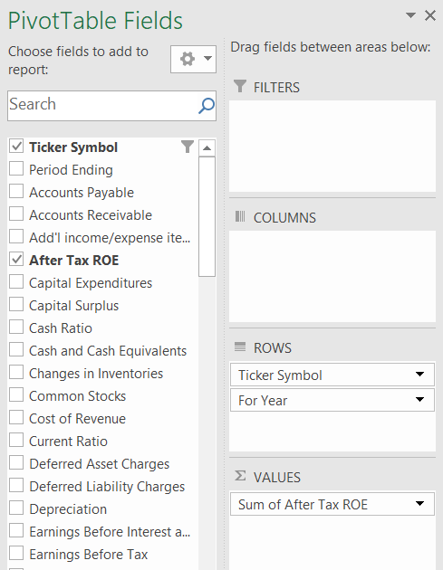
Which company had the highest "After Tax ROE" in 2013?
Row Labels | Sum of After Tax ROE
WYNN | 395
2013 | 395
Grand Total | 395

Slide 9
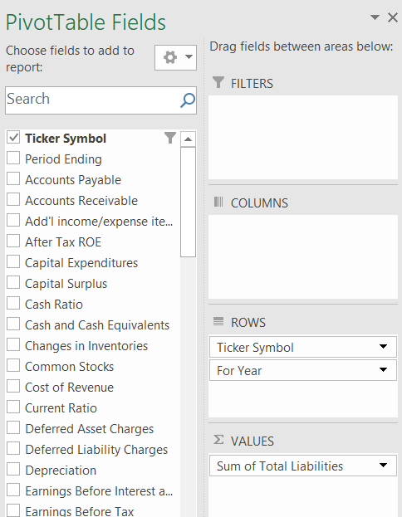
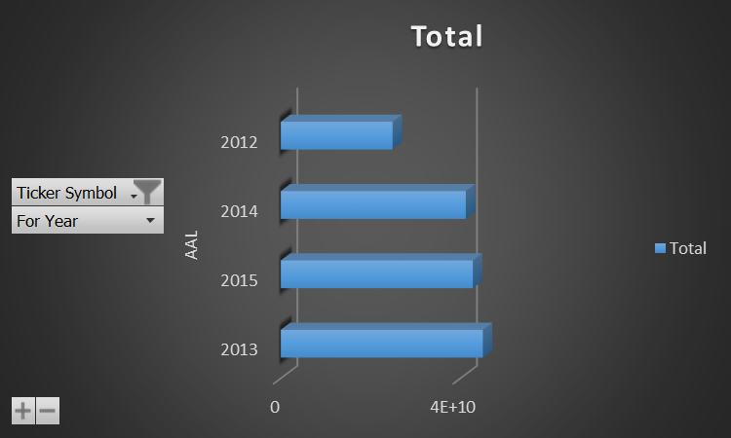
In which year did AAL have the largest "Total Liabilities"?
Row Labels | Sum of Total Liabilities
AAL | 1.53884E+11
2013 | 45009000000
2015 | 42780000000
2014 | 41204000000
2012 | 24891000000
Grand Total | 1.53884E+11

Slide 10
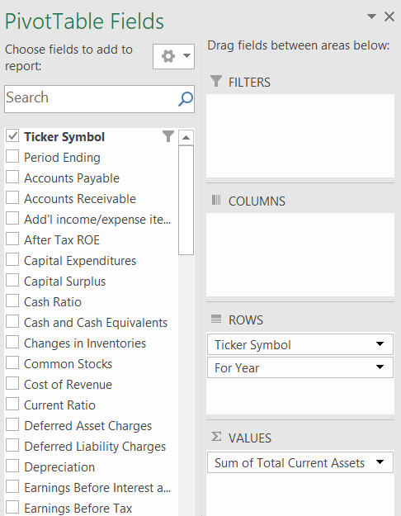
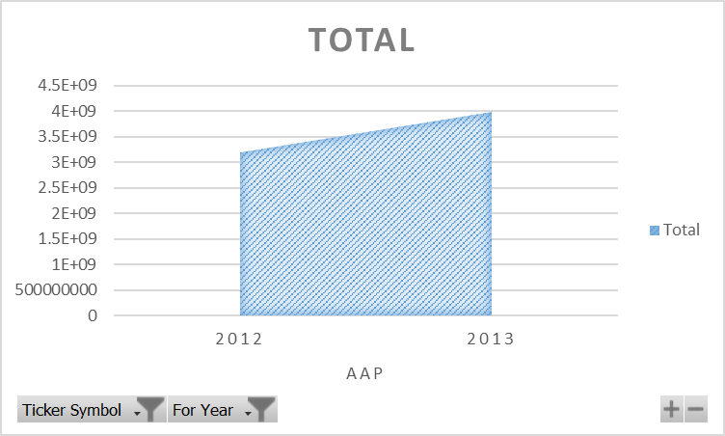
How did the "Total Current Assets" for AAP change between 2012 and 2013?
Row Labels | Sum of Total Current Assets
AAP | 7173584000
2012 | 3184200000
2013 | 3989384000
Grand Total | 7173584000

Slide 11
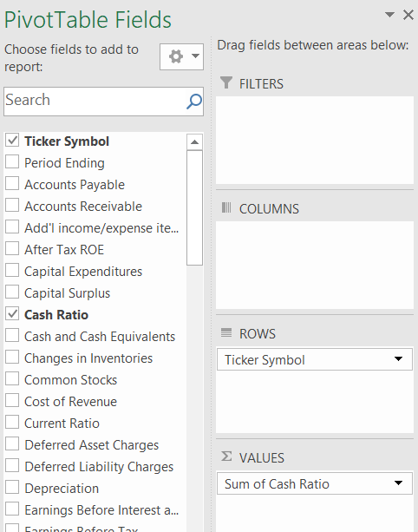
Which company reported the lowest "Cash Ratio" in 2014?
Row Labels | Sum of Cash Ratio
ZION | 0
HUM | 0
XL | 0
HCP | 0
HIG | 0
AIG | 0
AFL | 0
AIZ | 0
ALL | 0
JPM | 0
AMG | 0

Slide 12
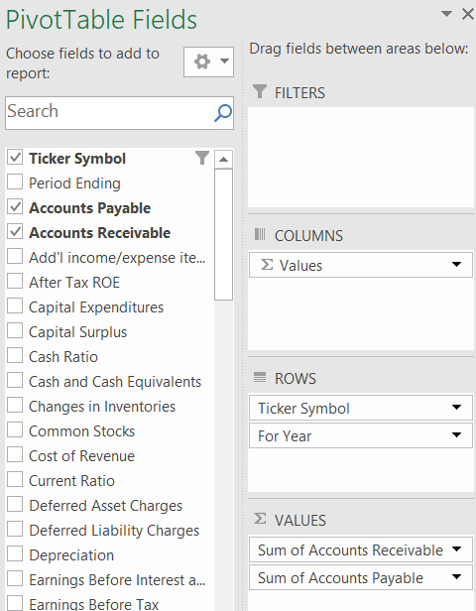
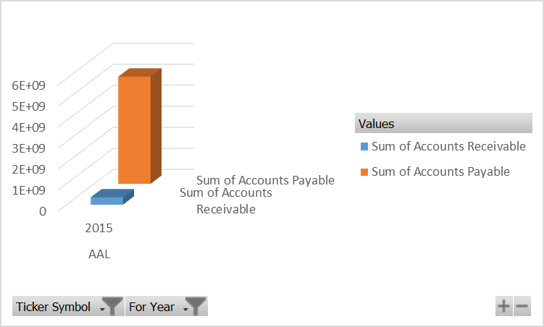
What is the difference between "Accounts Receivable" and "Accounts Payable" for AAL in 2015?
Row Labels | Sum of Accounts Receivable | Sum of Accounts Payable
AAL | 352000000 | 5102000000
2015 | 352000000 | 5102000000
Grand Total | 352000000 | 5102000000

Slide 13
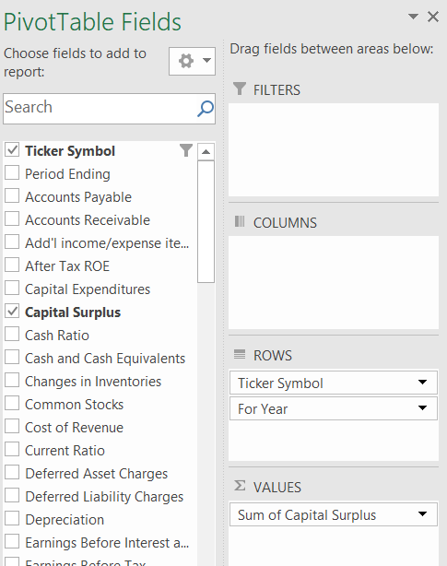
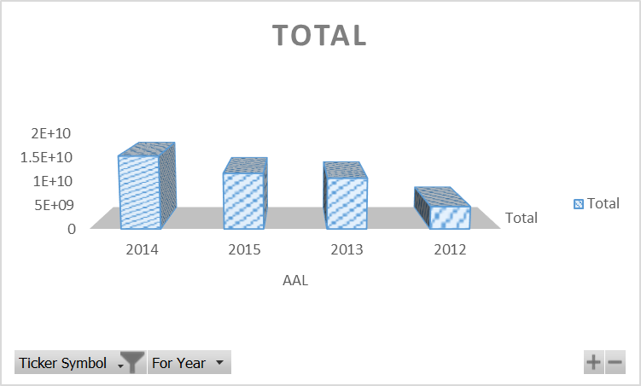
Which year saw the highest "Capital Surplus" for AAL?
Row Labels | Sum of Capital Surplus
AAL | 42013000000
2014 | 15135000000
2015 | 11591000000
2013 | 10592000000
2012 | 4695000000
Grand Total | 42013000000

Slide 14
Recommendation and Conclusion
Overall financial health: While the majority of US companies demonstrated strong financial health, there were notable variations across industries and company sizes.
Key financial trends: The most prominent trends observed included increasing profitability, rising debt levels, and growing mergers and acquisitions activity.
Sector performance: Technology and healthcare sectors outperformed other industries in terms of growth and profitability.
Risk and return profile: Investments in US stocks offered attractive returns

Slide 15
Thanks for Watching

Slide 16
Any Question?

